Slide 1


How SSRS Can be
Used to Create Financial Reports for GP
authored by Charles Allen, Microsoft MVP, BKD
Regional Chapters

Slide 2
Agenda
What is SQL Server Reporting Services?
Why Use SSRS for Financial Reports?
SSRS vs. Management Reporter/FRx
Best Practices
Components of a Report
Trial Balance
Income Statement
Sharing Best Practices?

Slide 3
What is SSRS?
Server-based reporting system
Suite of tools for creating reports
Browser or SharePoint-based Reports
Scheduled reports
Subscriptions

Slide 4
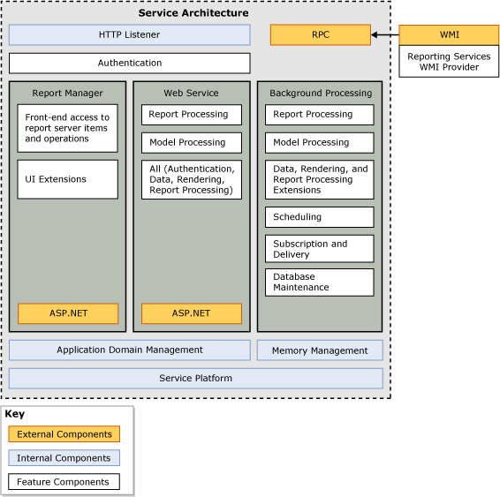
Architecture
http://msdn.microsoft.com/en-us/library/bb630409(v=SQL.100).aspx

Slide 5
Why Use for Financial Reports?
Consolidates reporting tools
Takes advantage of SQL Server
Include non-GP data
Can deploy to IIS or SharePoint
Notes:
Consolidates tools – SmartList, Excel Reports, GP Reports, SSRS, Management Reporter, Business Analyzer, Business Portal
Advantage of SQL Server – performance, security
Include non-GP data – SSRS can pull data from data in SQL Server and other sources. Microsoft SQL Server; Microsoft SQL Server Analysis Services for MDX, DMX, Microsoft PowerPivot, and tabular models; Microsoft SQL Azure; SQL Server Parallel Data Warehouse; Oracle; SAP NetWeaver BI; Hyperion Essbase; Microsoft SharePoint List; Teradata; OLE DB; ODBC; and XML.

Slide 6
SSRS vs. Management Reporter/FRx
 | SSRS | Management Reporter
Report Formatting | Very flexible and based upon how the report is written | Limited to the report component structure
Knowledge to Create Reports | Can require technical knowledge of Transact-SQL to build reports | Utilizes easy-to-understand structure
Drill Down | Drill down reports can be created within reports and to other reports | Drill down functionality is built into the product and you can drill into GP
Speed | Utilizes the server for processing | Not known for speed

Slide 7
Components of a Report
Data Source
Data Set
Parameters
Report Layout
Notes:
Data Source – Identifies the source of the data
Data Set – Determines the data from the source to be used in the report
Report Layout – The way the report looks
Parameters – information to drive the data

Slide 8
Data Source
Defines where the data originates (SQL table, Excel spreadsheet, etc.)
Best if set up as shared – can be used for multiple reports
Good for security
GP’s BI deployment tool creates a data source for each company

Slide 9
Types of Data Sets
Embedded
Not very portable between reports
Query must be evaluated by the server each time the report is run
Shared Data Set
Portable because it can be used in multiple reports
Can be updated separately from the reports that use it

Slide 10
Components of a Data Set
Select from Tables
select custnmbr, custname from RM00101
Select from Views
Similar to using a table
select [Customer Number], [Customer Name] from [Customers]
Call a Stored Procedure
Faster performance
Simple syntax (Just enter the name of the sp in the query)

Slide 11
Stored Procedures vs. Queries
Speed – the server already knows how to use the stored procedure
Simplicity – just enter the name of the stored procedure
Security – only need security to run the stored procedure

Slide 12
Stored Procedures vs. Queries
Reusability – stored procedures can be used over and over
Maintainability – Change the stored procedure but keep the columns for the report the same
Microsoft SQL Server 2012 Reporting Services, 4th Edition, Pages 439-440

Slide 13
Parameters
Provide user-interaction with the report
Can be different types (date, dropdown list, string, numeric, etc.)
Can be dependent upon other parameters (Show Parameter 2 depending upon Parameter 1’s value)

Slide 14
Best Practices
Use Report Templates
Use Shared Data Sources
Use Views and Stored Procedures
Use Navigation Features
Microsoft SQL Server 2012 Reporting Services, 4th Edition, Pages 738-739

Slide 15
Demo Environment Information
Windows 7 Workstation
GP 2010 R2
SQL Server 2012
8 GB RAM
Update with your info

Slide 16
Trial Balance
Will use a stored procedure (Best Practice!)
Include a drill down to a GP window
Prompt for a fiscal year and trx date range

Slide 17
Trial Balance
Stored Procedure for Details: spGPUGTrialBalance
Stored Procedure for Report Totals: spGPUGTrialBalanceTotals

Slide 18
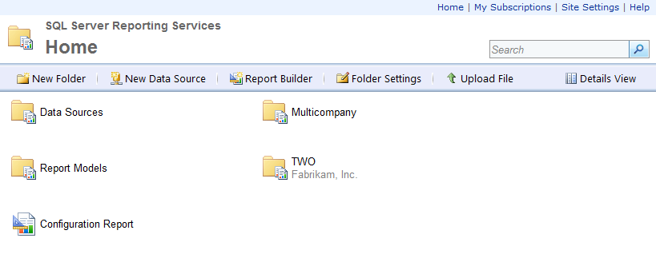
Trial Balance
Go to the Report Manager Website

Slide 19
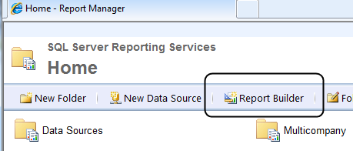
Trial Balance
Launch Report Builder 3.0

Slide 20
Income Statement
Many ways to create a report
Account Categories?
Other types of account groupings?
The more detailed, the more work

Slide 21
Income Statement
Segment Descriptions
Make sure they are populated
Simple query for Fabrikam to update the GL40200 table
Update a
set a.dscriptn = Left(b.actdescr,30)
from gl40200 a
inner join gl00100 b on a.SGMNTID = b.ACTNUMBR_2 where a.SGMTNUMB = 2

Slide 22
Income Statement
Conceptual Ways to Build Rows
Use queries in your sp to add data one row at a time
Create separate datasets where each one defines the information to display

Slide 23
Resources
Books
Larson, Brian. Microsoft SQL Server 2012 Reporting Services. 4th. McGraw-Hill, 2012. Print.
Whaley, Richard. Creating Reports with SQL Reporting Services. Print.
Misner, Stacia. Microsoft SQL Server 2008 Reporting Services Step by Step. Microsoft Press. Print.
Online
Learn It First (www.learnitfirst.com)
MSDN Reporting Services (SSRS)
http://msdn.microsoft.com/en-us/library/ms159106.aspx

Slide 24
Sharing Best Practices
Your experiences?
Questions?

